Slide 1

Exporting for Growth
UK Trade & Investment’s Role
Presented by Rob Lewtas
Notes:
Clients to be given handout copies of slides NOW.
(3 per page with notes spaces)
Please make sure your name is added to the slide and that the date is added to the footer on each slide.

Slide 2
Topics to cover today
The rationale for exporting
Changing export markets
Who are UKTI and how can we help

Slide 3

Why should companies export
Companies that export are 11% more likely to stay in business

Slide 4
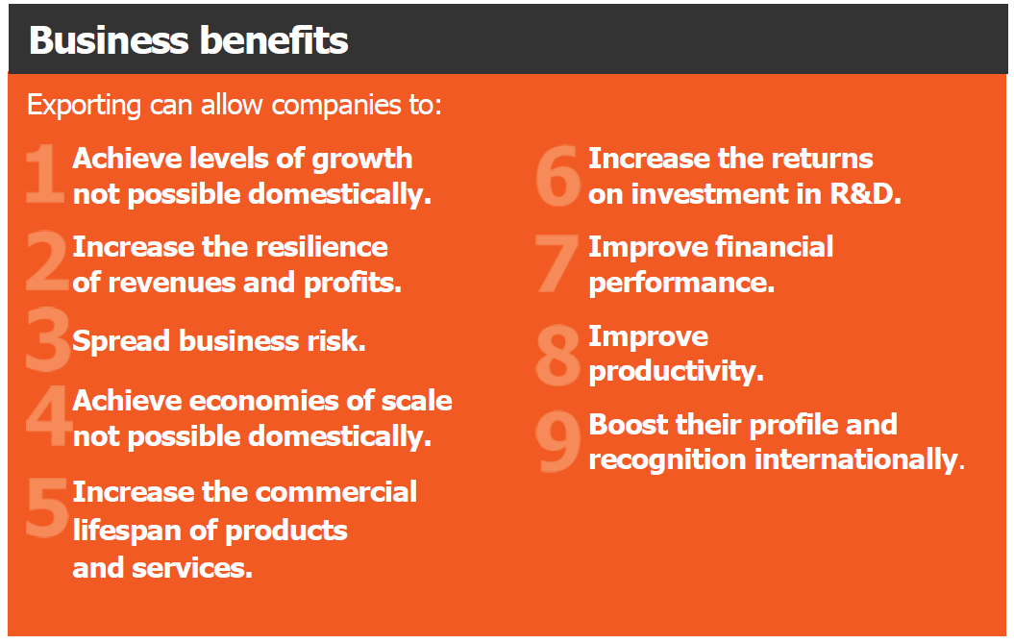
Why Export ?

Slide 5
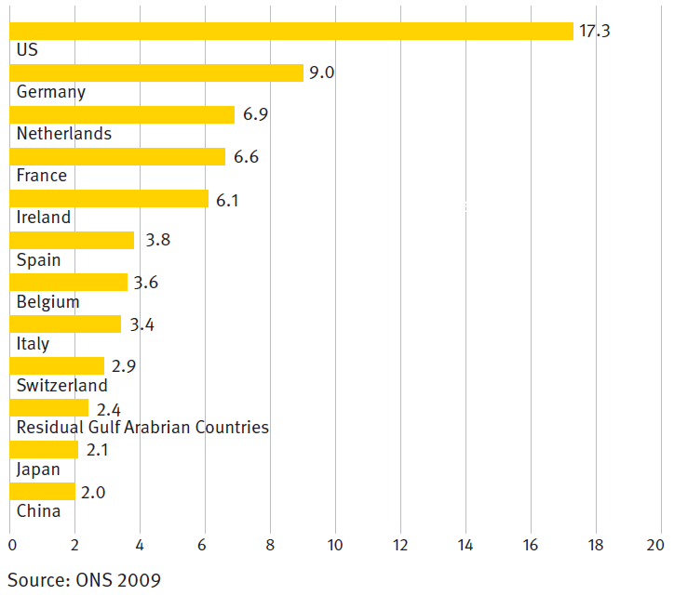
Where to export to
Current UK Export Destinations

Slide 6
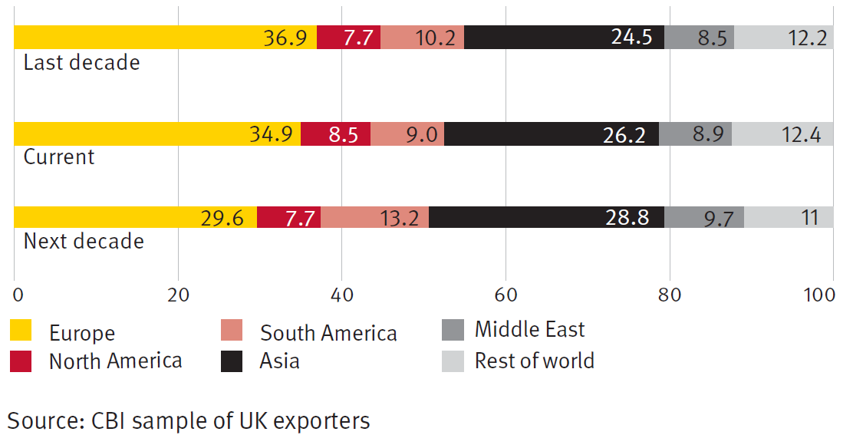
Changing Export Market Destinations

Slide 7
Where to Export to?
Rise to Power of Emerging Economies
Brazil, Russia, India, China.
  Significant influence on regional & global affairs
  Developing & very large (one third of the world’s population)
  Newly Industrialised
Columbia, Indonesia, Vietnam, Egypt, Turkey, South Africa
  Sophisticated financial systems
  Controlled inflation
  Soaring young population
  Possessed of natural resources
BUT DON’T NEGLECT THE OBVIOUS… EU, USA, AusNZ, etc.
Notes:
In 2006, the foreign ministers of 4 countries met in NY (‘high level meetings’)
By 2008/09 diplomatic meetings had taken place in which collective decisions were made to ‘get more involved in global affairs’ leading to >
BRICS Forum in April 2011: ‘co-operate commercially, politically & culturally’
S moved up > South Africa on 24/12/2010 became the 5th economy to become part of the club
So, they started to ‘club together’ in which they can exert power, influence & strong voice
What characterises the ‘strong voice’ : huge populations, fast growth/industrialising
eg China : 1.34bn citizens, 400m middle classes, urbanised @ 10 mega-cities x 27m people, 100,000 infrastructure projects x $2.66trn spend from 2008 to 2018
Take India : 1.12bn, 300m m/classes, $620bn I/spend
Substrata CIVETs (mnemonic favoured by Michael Geoghegan!) > growth outstripping BRICS
T&C presidents in UK right now : improve links, seek investment
Turkey – 10% growth in H1/2011, diversified economy/skilled, low sovereign & household debt, growing population 50% < 30; fastest growth of all OECD countries (Istanbul behind London, NY, Tokyo as financial centre!!)
Columbia : never ending terrorist war, favourable foregin business creation, FDI up 250%, I/spend up
Indonesia : similar to India & China, rising rapidly – 243m people, GDP $521bn
Vietnam : clothes/shoes, low labour costs
Similar characteristics : no debt, moving to consumption/demand driven (exact opposite of us)

Slide 8

UKTI... Who we are and what we do
Notes:
The Inward Investment Service is delivered jointly by PA Consulting Group, OCO Consulting and British Chambers of Commerce (collectively known as the Investment Services Team).
The UKTI Investment Services Team is responsible for:
Coordinating and managing the delivery of FDI support for the United Kingdom with prospective foreign direct investors.
We do this by working with local partners across England, the devolved administrations of Scotland, Wales and Northern Ireland, the Greater London Authority, and the UKTI and wider FDI network.
Providing direct relationship management and investor development, in association with international, national and local stakeholders (including the Devolved Administrations and London & Partners) to nominated existing investors in the UK as agreed with UKTI

Slide 9
UKTI Overview
Notes:
Purpose and structure

Slide 10

UKTI Overview
Responsible for Inward Investment & International Trade Support
2,400 staff
1,300 overseas
99 UK Embassies, High Commissions, Consulates and Trade Offices; and around
400 Advisers and support staff in nine English regions

Slide 11
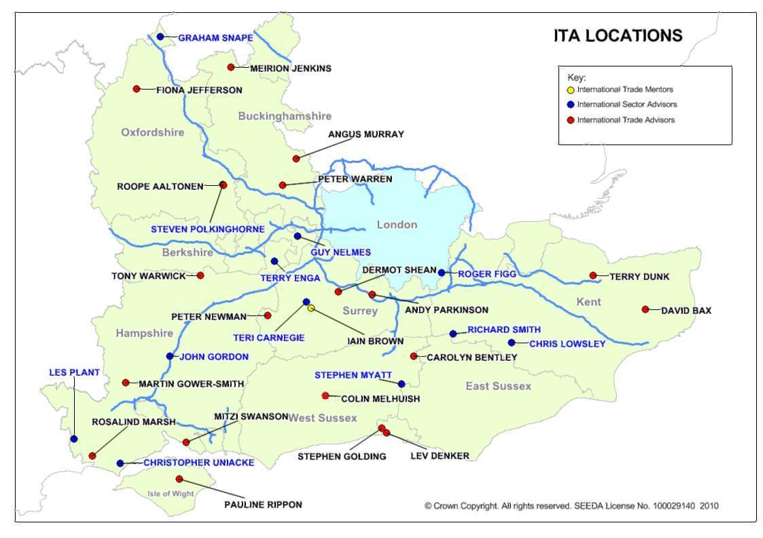
ITA Locations
LONDON X2

Slide 12
Why we do what we do... Some Key Facts
For every £1 that UKTI spends, £22 is generated for the UK economy.
UKTI’s estimated total financial benefit to businesses across all trade services was around £6 billion last year, up from £5 billion the previous year.
This additional profit has helped create or retain more than 126,000 jobs in the UK,
Over 3,000 companies increased R&D activity in the UK as a result of UKTI support.
UKTI assisted 24,400 companies to exploit opportunities in overseas markets over 2011-12 period.

Slide 13
UKTI Impartial advice & strategic support
Strategic and export business advice
Market information and research
Assistance in identifying partners and potential customers
Assistance to promote company products
Support to visit markets
Support whilst in market
Identification of business opportunities

Slide 14
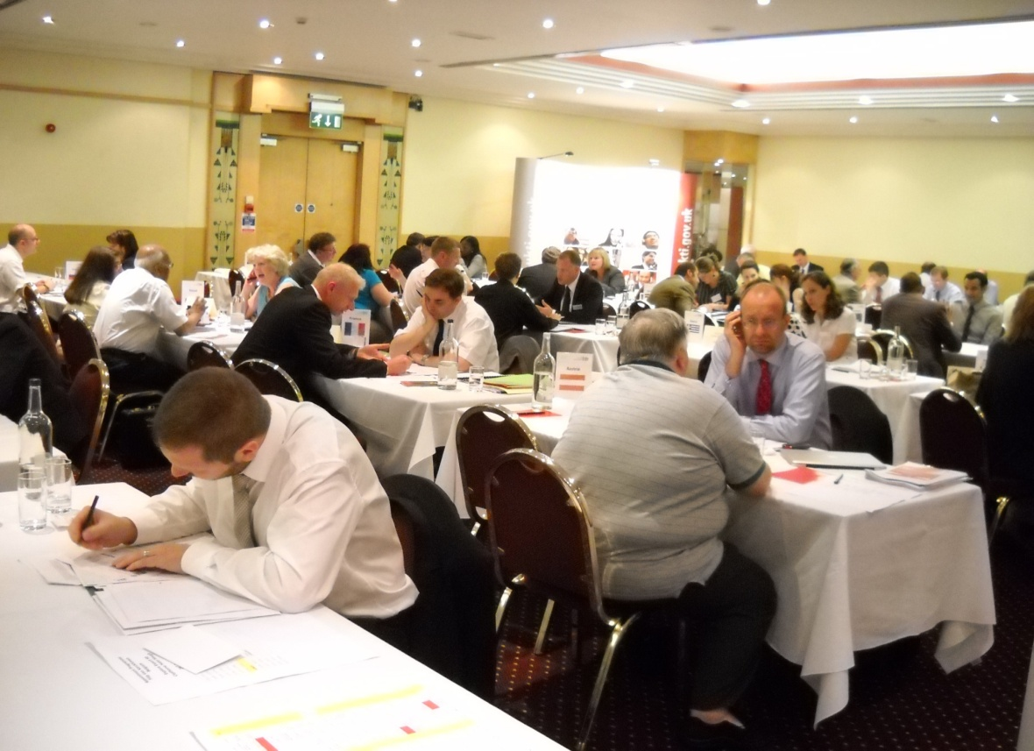
Our Services
Activity Programme 2012
  117 events this year
  2000+ attendees
  30+ training events for businesses
  14 overseas missions
Notes:
All advisers are ex-private sector – won’t offer impractical / expensive suggestions
Almost any question can be answered – “I know a man who can”
Mention the service:
‘Solutions for Business’ is the name for publicly funded business support - offering a range of services and solutions to meet real business needs.
‘Solutions for Business’ brings together and simplifies the range of support offered to businesses by government departments, their agencies and local authorities in England.
UKTI provides support for UK exporters under the Government’s ‘Solutions for Business’ portfolio of business support.
Examples are – Business Link, Manufacturing Advisory Service
See notes for Slide 2 for the update on Business Link.

Slide 15
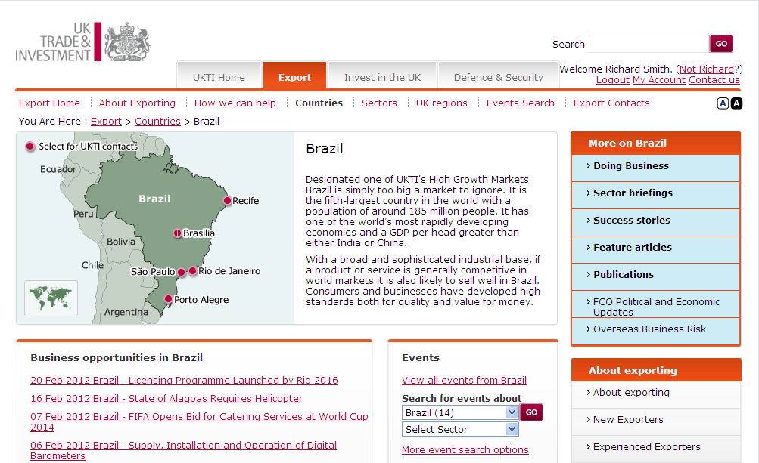
Web Resources National Site www.ukti.gov.uk
Notes:
Example country page (Brazil)
Note Opportunities, Events etc. down RHS

Slide 16
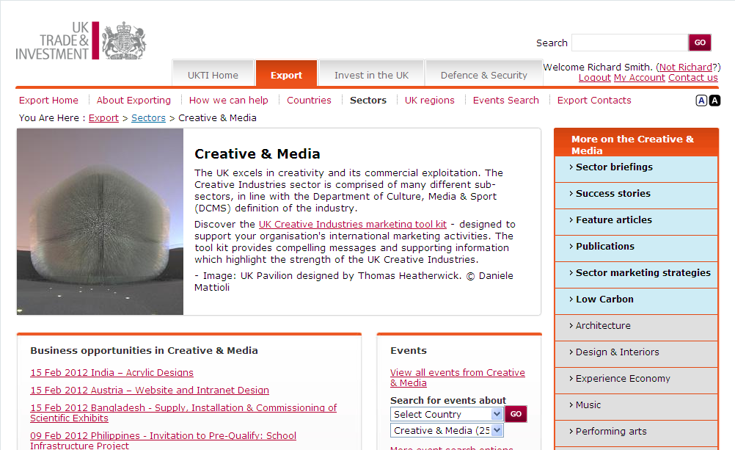
Web Resources National Site www.ukti.gov.uk
Notes:
Example Sector page (Creative and Media)

Slide 17
New programmes to help achieve our goals
Finance
  UK Export Finance changes
  Appointment of regional UK Export Finance Specialist Advisor
Trade Missions –
  high level support
  Increased efforts on trade shows and industry sector events
High Value Opportunities
  Tier #1 support
  Supply chain development through dialogue with Tier#1’s
Notes:
HVO’s
Identify projects offering the most value to the UK;
Support UK businesses in developing and implementing strategies to win contracts in and around HVOs;
Bring together expertise from across our network, alongside private sector business specialists.
Build strong relationships with key UK businesses able to deliver against these opportunities, facilitating the development of partnerships/consortia where appropriate.
Participation in the programme is open to businesses of all sizes. Lead contracts will often be won by larger companies, but there will also be huge supply chain opportunities for smaller companies.

Slide 18
Discussion & Questions
Notes:
Clients to be given handout copies of slides NOW.
(3 per page with notes spaces)
Please make sure your name is added to the slide and that the date is added to the footer on each slide.

